Slide 1
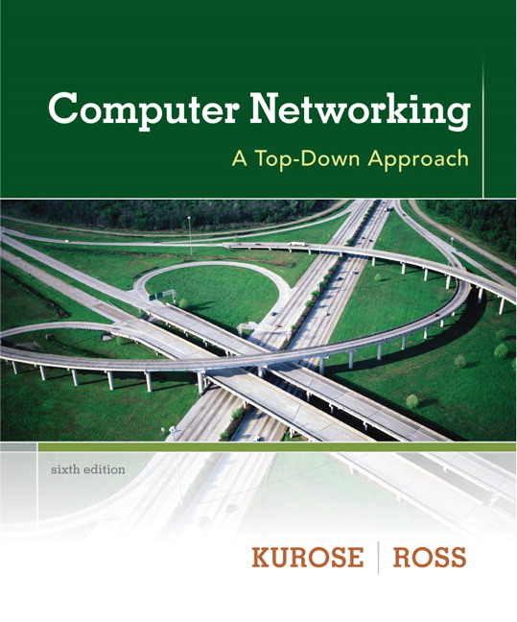

Chapter 8
Security
Computer Networking: A Top Down Approach
6th edition
Jim Kurose, Keith Ross
Addison-Wesley
March 2012
A note on the use of these ppt slides:
We’re making these slides freely available to all (faculty, students, readers). They’re in PowerPoint form so you see the animations; and can add, modify, and delete slides (including this one) and slide content to suit your needs. They obviously represent a lot of work on our part. In return for use, we only ask the following:
If you use these slides (e.g., in a class) that you mention their source (after all, we’d like people to use our book!)
If you post any slides on a www site, that you note that they are adapted from (or perhaps identical to) our slides, and note our copyright of this material.
Thanks and enjoy! JFK/KWR
All material copyright 1996-2012
J.F Kurose and K.W. Ross, All Rights Reserved

Slide 2
What is network security?
confidentiality: only sender, intended receiver should “understand” message contents
  sender encrypts message
  receiver decrypts message
authentication: sender, receiver want to confirm identity of each other
message integrity: sender, receiver want to ensure message not altered (in transit, or afterwards) without detection
access and availability: services must be accessible and available to users

Slide 3



Friends and enemies: Alice, Bob, Trudy
well-known in network security world
Bob, Alice (lovers!) want to communicate “securely”
Trudy (intruder) may intercept, delete, add messages
Alice
Bob
channel
data, control messages
secure
sender
s
data
secure
receiver
data
Trudy

Slide 4
Who might Bob, Alice be?
… well, real-life Bobs and Alices!
Web browser/server for electronic transactions (e.g., on-line purchases)
on-line banking client/server
DNS servers
routers exchanging routing table updates
other examples?

Slide 5
There are bad guys (and girls) out there!
Q: What can a “bad guy” do?
A: A lot! See section 1.6
  eavesdrop: intercept messages
  actively insert messages into connection
  impersonation: can fake (spoof) source address in packet (or any field in packet)
  hijacking: “take over” ongoing connection by removing sender or receiver, inserting himself in place
  denial of service: prevent service from being used by others (e.g., by overloading resources)

Slide 6
Breaking an encryption scheme
cipher-text only attack: Trudy has ciphertext she can analyze
two approaches:
  brute force: search through all keys
  statistical analysis
known-plaintext attack: Trudy has plaintext corresponding to ciphertext
  e.g., in monoalphabetic cipher, Trudy determines pairings for a,l,i,c,e,b,o,
chosen-plaintext attack: Trudy can get ciphertext for chosen plaintext

Slide 7
Public Key Cryptography
symmetric key crypto
requires sender, receiver know shared secret key
Q: how to agree on key in first place (particularly if never “met”)?
public key crypto
radically different approach [Diffie-Hellman76, RSA78]
sender, receiver do not share secret key
public encryption key known to all
private decryption key known only to receiver

Slide 8
Public key cryptography
+
Bob’s public
key
K
B
-
Bob’s private
key
K
B
plaintext
message, m
encryption
algorithm
ciphertext
decryption
algorithm
plaintext
message
+
K (m)
-
+
B
m = K (K (m))
B
B

Slide 9
Public key encryption algorithms
requirements:
.
.
+
-
1
need K ( ) and K ( ) such that
B
B
-
+
K (K (m)) = m
B
B
2
+
given public key K , it should be impossible to compute private key K
B
-
B
RSA: Rivest, Shamir, Adelson algorithm

Slide 10
Prerequisite: modular arithmetic
x mod n = remainder of x when divide by n
facts:
  [(a mod n) + (b mod n)] mod n = (a+b) mod n
  [(a mod n) - (b mod n)] mod n = (a-b) mod n
  [(a mod n) * (b mod n)] mod n = (a*b) mod n
thus
(a mod n)^{d} mod n = a^{d} mod n
example: x=14, n=10, d=2:
(x mod n)^{d} mod n = 4² mod 10 = 6
x^{d} = 14² = 196 x^{d} mod 10 = 6

Slide 11
RSA: getting ready
message: just a bit pattern
bit pattern can be uniquely represented by an integer number
thus, encrypting a message is equivalent to encrypting a number.
example:
m= 10010001 . This message is uniquely represented by the decimal number 145.
to encrypt m, we encrypt the corresponding number, which gives a new number (the ciphertext).

Slide 12
RSA: Creating public/private key pair
1. choose two large prime numbers p, q.
(e.g., 1024 bits each)
2. compute n = pq, z = (p-1)(q-1)
3. choose e (with e<n) that has no common factors
with z (e, z are “relatively prime”).
4. choose d such that ed-1 is exactly divisible by z.
(in other words: ed mod z = 1 ).
5. public key is (n,e). private key is (n,d).
+
-
K
K
B
B

Slide 13
RSA: encryption, decryption
0. given (n,e) and (n,d) as computed above
1. to encrypt message m (<n), compute
e
c = m mod n
2. to decrypt received bit pattern, c, compute
d
m = c mod n
magic
happens!
e
d
m = (m mod n)
mod n
c

Slide 14
RSA example:
Bob chooses p=5, q=7. Then n=35, z=24.
e=5 (so e, z relatively prime).
d=29 (so ed-1 exactly divisible by z).
encrypting 8-bit messages.
m
e
e
bit pattern
m
c = m mod n
encrypt:
0000l000
12
24832
17
d
d
c
c
m = c mod n
decrypt:
17
481968572106750915091411825223071697
12

Slide 15
Why does RSA work?
must show that c^{d} mod n = m
where c = m^{e} mod n
fact: for any x and y: x^{y} mod n = x^{(y mod z)} mod n
  where n= pq and z = (p-1)(q-1)
thus,
c^{d} mod n = (m^{e} mod n)^{d} mod n
= m^{ed} mod n
= m^{(ed mod z)} mod n
= m¹ mod n
= m

Slide 16
RSA: another important property
The following property will be very useful later:
-
+
+
-
K (K (m)) = m
=
K (K (m))
B
B
B
B
use public key first, followed by private key
use private key first, followed by public key
result is the same!

Slide 17
Why
-
+
+
-
K (K (m)) = m
?
=
K (K (m))
B
B
B
B
follows directly from modular arithmetic:
(m^{e} mod n)^{d} mod n = m^{ed} mod n
= m^{de} mod n
= (m^{d} mod n)^{e} mod n

Slide 18
Why is RSA secure?
suppose you know Bob’s public key (n,e). How hard is it to determine d?
essentially need to find factors of n without knowing the two factors p and q
  fact: factoring a big number is hard

Slide 19
Chapter 8 roadmap
8.1 What is network security?
8.2 Principles of cryptography
8.3 Message integrity, authentication
8.4 Securing e-mail
8.5 Securing TCP connections: SSL
8.6 Network layer security: IPsec
8.7 Securing wireless LANs
8.8 Operational security: firewalls and IDS

Slide 20
Authentication
Goal: Bob wants Alice to “prove” her identity to him
Protocol ap1.0: Alice says “I am Alice”
“I am Alice”
Failure scenario??

Slide 21
Authentication
Goal: Bob wants Alice to “prove” her identity to him
Protocol ap1.0: Alice says “I am Alice”
in a network,
Bob can not “see” Alice, so Trudy simply declares
herself to be Alice
“I am Alice”

Slide 22
Authentication: another try
Protocol ap2.0: Alice says “I am Alice” in an IP packet
containing her source IP address
Alice’s
IP address
“I am Alice”
Failure scenario??

Slide 23
Authentication: another try
Protocol ap2.0: Alice says “I am Alice” in an IP packet
containing her source IP address
Trudy can create
a packet “spoofing”
Alice’s address
Alice’s
IP address
“I am Alice”

Slide 24
Authentication: another try
Protocol ap3.0: Alice says “I am Alice” and sends her
secret password to “prove” it.
Alice’s
IP addr
Alice’s
password
“I’m Alice”
Failure scenario??
Alice’s
IP addr
OK

Slide 25
Authentication: another try
Protocol ap3.0: Alice says “I am Alice” and sends her
secret password to “prove” it.
Alice’s
IP addr
Alice’s
password
“I’m Alice”
playback attack: Trudy records Alice’s packet
and later
plays it back to Bob
Alice’s
IP addr
OK
Alice’s
IP addr
Alice’s
password
“I’m Alice”

Slide 26
Authentication: yet another try
Protocol ap3.1: Alice says “I am Alice” and sends her
encrypted secret password to “prove” it.
Alice’s
IP addr
encrypted
password
“I’m Alice”
Failure scenario??
Alice’s
IP addr
OK

Slide 27
Authentication: yet another try
Protocol ap3.1: Alice says “I am Alice” and sends her
encrypted secret password to “prove” it.
Alice’s
IP addr
encrypted
password
“I’m Alice”
record
and
playback
still works!
Alice’s
IP addr
OK
Alice’s
IP addr
encrypted
password
“I’m Alice”

Slide 28
Authentication: yet another try
Goal: avoid playback attack
nonce: number (R) used only once-in-a-lifetime
ap4.0: to prove Alice “live”, Bob sends Alice nonce, R. Alice
must return R, encrypted with shared secret key
“I am Alice”
R
K (R)
Alice is live, and only Alice knows key to encrypt nonce, so it must be Alice!
A-B
Failures, drawbacks?

Slide 29
Authentication: ap5.0
ap4.0 requires shared symmetric key
can we authenticate using public key techniques?
ap5.0: use nonce, public key cryptography
“I am Alice”
Bob computes
R
+
-
-
K
(K (R)) = R
K (R)
A
A
A
and knows only Alice could have the private key, that encrypted R such that
“send me your public key”
+
K
A
+
-
K
(K (R)) = R
A
A

Slide 30
ap5.0: security hole
man (or woman) in the middle attack: Trudy poses as Alice (to Bob) and as Bob (to Alice)
I am Alice
I am Alice
R
-
K (R)
T
R
-
Send me your public key
K (R)
+
A
K
T
Send me your public key
+
K
A
+
K (m)
Trudy gets
T
-
+
+
m = K (K (m))
K (m)
T
T
-
A
sends m to Alice encrypted with Alice’s public key
+
m = K (K (m))
A
A

Slide 31
ap5.0: security hole
man (or woman) in the middle attack: Trudy poses as Alice (to Bob) and as Bob (to Alice)
difficult to detect:
Bob receives everything that Alice sends, and vice versa. (e.g., so Bob, Alice can meet one week later and recall conversation!)
problem is that Trudy receives all messages as well!

Slide 32
Chapter 8 roadmap
8.1 What is network security?
8.2 Principles of cryptography
8.3 Message integrity, authentication
8.4 Securing e-mail
8.5 Securing TCP connections: SSL
8.6 Network layer security: IPsec
8.7 Securing wireless LANs
8.8 Operational security: firewalls and IDS

Slide 33
Digital signatures
cryptographic technique analogous to hand-written signatures:
sender (Bob) digitally signs document, establishing he is document owner/creator.
verifiable, nonforgeable: recipient (Alice) can prove to someone that Bob, and no one else (including Alice), must have signed document

Slide 34
Digital signatures
simple digital signature for message m:
Bob signs m by encrypting with his private key K_{B}, creating “signed” message, K_{B}(m)
-
-
Bob’s message, m
-
Bob’s private
key
-
K
m,K
(m)
B
B
Dear Alice
Oh, how I have missed you. I think of you all the time! …(blah blah blah)
Bob
Bob’s message, m, signed (encrypted) with his private key
Public key
encryption
algorithm

Slide 35
Digital signatures
-
suppose Alice receives msg m, with signature: m, K_{B}(m)
Alice verifies m signed by Bob by applying Bob’s public key K_{B} to K_{B}(m) then checks K_{B}(K_{B}(m) ) = m.
If K_{B}(K_{B}(m) ) = m, whoever signed m must have used Bob’s private key.
+
-
+
-
+
-
Alice thus verifies that:
  Bob signed m
  no one else signed m
  Bob signed m and not m‘
non-repudiation:
  Alice can take m, and signature K_{B}(m) to court and prove that Bob signed m
-

Slide 36
Message digests
large
message
m
H: Hash
Function
computationally expensive to public-key-encrypt long messages
goal: fixed-length, easy- to-compute digital “fingerprint”
apply hash function H to m, get fixed size message digest, H(m).
H(m)
Hash function properties:
many-to-1
produces fixed-size msg digest (fingerprint)
given message digest x, computationally infeasible to find m such that x = H(m)

Slide 37
Internet checksum: poor crypto hash function
Internet checksum has some properties of hash function:
produces fixed length digest (16-bit sum) of message
is many-to-one
But given message with given hash value, it is easy to find another message with same hash value:
message
ASCII format
message
ASCII format
I O U 1
0 0 . 9
9 B O B
49 4F 55 31
30 30 2E 39
39 42 D2 42
I O U 9
0 0 . 1
9 B O B
49 4F 55 39
30 30 2E 31
39 42 D2 42
B2 C1 D2 AC
different messages
but identical checksums!
B2 C1 D2 AC

Slide 38
Digital signature = signed message digest
Bob sends digitally signed message:
Alice verifies signature, integrity of digitally signed message:
large
message
m
H: Hash
function
H(m)
encrypted
msg digest
-
K_{B}(H(m))
Bob’s
private
key
digital
signature
(encrypt)
large
message
m
-
Bob’s
public
key
digital
signature
(decrypt)
K
B
+
H: Hash
function
K
encrypted
msg digest
B
+
-
K_{B}(H(m))
H(m)
H(m)
equal
?

Slide 39
Hash function algorithms
MD5 hash function widely used (RFC 1321)
  computes 128-bit message digest in 4-step process.
  arbitrary 128-bit string x, appears difficult to construct msg m whose MD5 hash is equal to x
SHA-1 is also used
  US standard [NIST, FIPS PUB 180-1]
  160-bit message digest

Slide 40
Recall: ap5.0 security hole
man (or woman) in the middle attack: Trudy poses as Alice (to Bob) and as Bob (to Alice)
I am Alice
I am Alice
R
-
K (R)
T
R
-
Send me your public key
K (R)
+
A
K
T
Send me your public key
+
K
A
+
K (m)
Trudy gets
T
-
+
+
m = K (K (m))
K (m)
T
T
-
A
sends m to Alice encrypted with Alice’s public key
+
m = K (K (m))
A
A

Slide 41
Public-key certification
motivation: Trudy plays pizza prank on Bob
  Trudy creates e-mail order:
  Dear Pizza Store, Please deliver to me four pepperoni pizzas. Thank you, Bob
  Trudy signs order with her private key
  Trudy sends order to Pizza Store
  Trudy sends to Pizza Store her public key, but says it’s Bob’s public key
  Pizza Store verifies signature; then delivers four pepperoni pizzas to Bob
  Bob doesn’t even like pepperoni

Slide 42
Certification authorities
certification authority (CA): binds public key to particular entity, E.
E (person, router) registers its public key with CA.
  E provides “proof of identity” to CA.
  CA creates certificate binding E to its public key.
  certificate containing E’s public key digitally signed by CA – CA says “this is E’s public key”
Bob’s
public
key
digital
signature
(encrypt)
+
K
+
B
K
B
CA
private
key
certificate for Bob’s public key, signed by CA
-
Bob’s
identifying information
K
CA

Slide 43
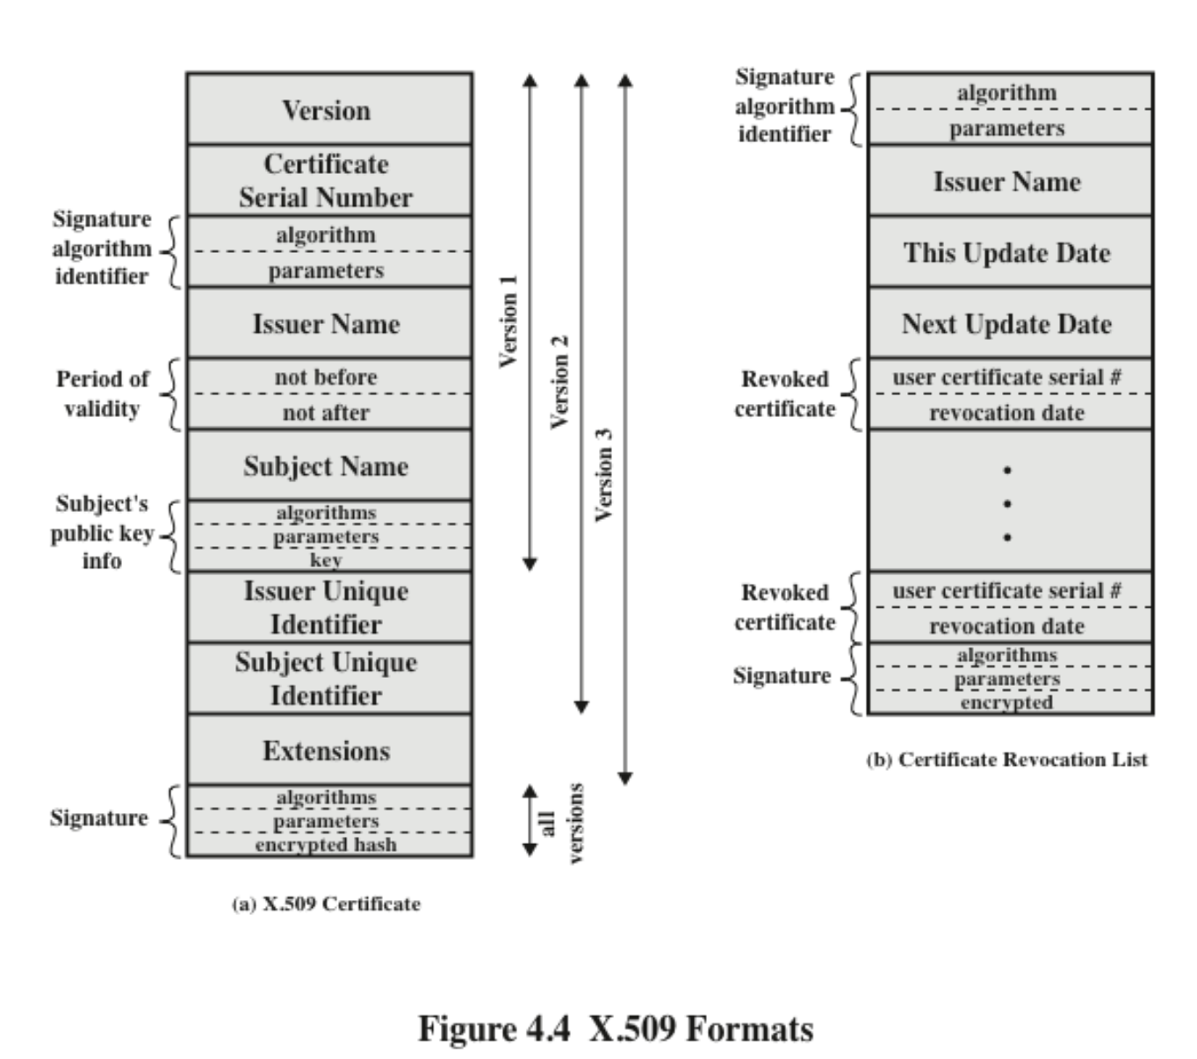
X509 Certificate format

